Slide 1
Local File Inclusion
GUIDE :
MR. KARTHEEK CHANDA
s-design.com

Slide 2

Objectives
File Inclusion Using LFI Suite
File Inclusion through BWAPP

Slide 3
Agenda
01
What ?
02
Why ?
03
How?

Slide 4
What Is File Inclusion?
An attacker can use Local File Inclusion (LFI) to trick the web application into exposing or running files on the web server. An LFI attack may lead to information disclosure, remote code execution, or even Cross-site Scripting (XSS)
Why File Inclusion? e(XSS)
A Local File Inclusion attack is used to trick the application into exposing or running files on the server. They allow attackers to execute arbitrary commands or, if the server is misconfigured and running with high privileges, to gain access to sensitive data.
How File Inclusion?
These attacks typically occur when an application uses the path to a file as input. If the application treats that input as trusted, an attacker can use the local file in an include statement.
While Local File Inclusion and Remote File Inclusion are very similar, an attacker using LFI may include only local files.

Slide 5
File Inclusion Through LFI Suite
LFI SUITE :
LFI Suite is a totally automatic tool able to scan and exploit Local File Inclusion vulnerabilities using many different methods of attack, listed below.
Features:
Works with Windows, Linux and OS X
Automatic Configuration
Automatic Update
Provides 8 different Local File Inclusion attack modalities:
/proc/self/environ
php://filter
php://input
/proc/self/fd
access log
data://
expect://
Tor proxy support
Reverse Shell for Windows, Linux and OS X

Slide 6
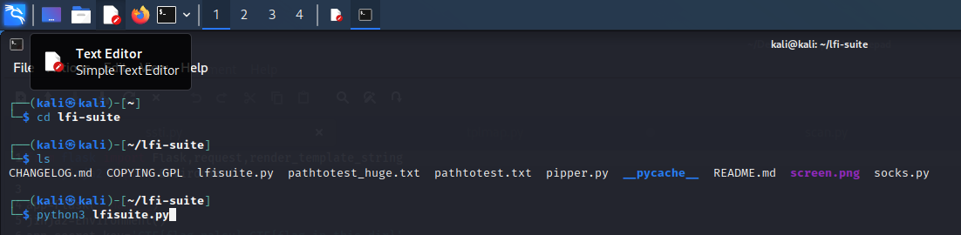
Implementation Of File Inclusion Through LFI Suite
STEP 1:

Slide 7
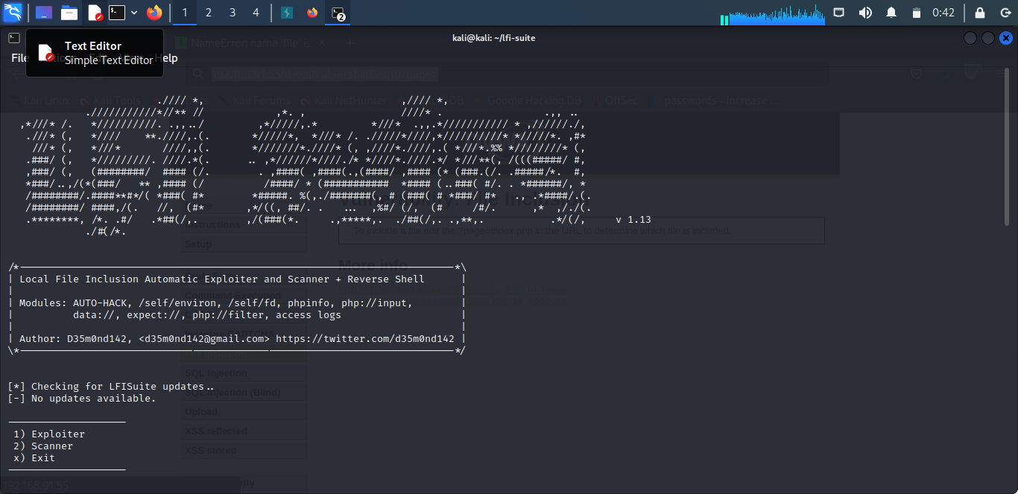
STEP-2:

Slide 8
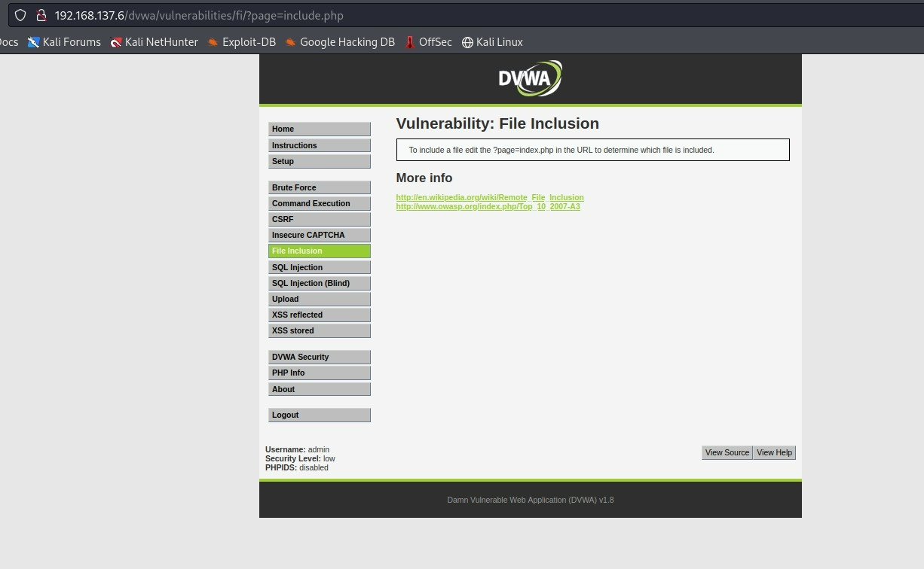
STEP- 3:

Slide 9
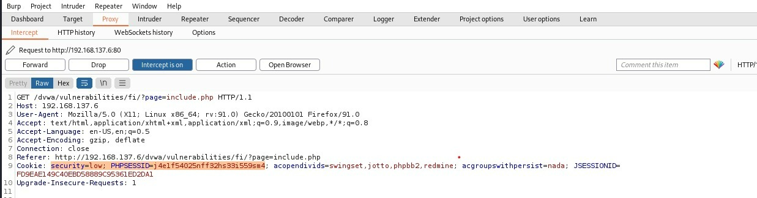
STEP- 4:

Slide 10
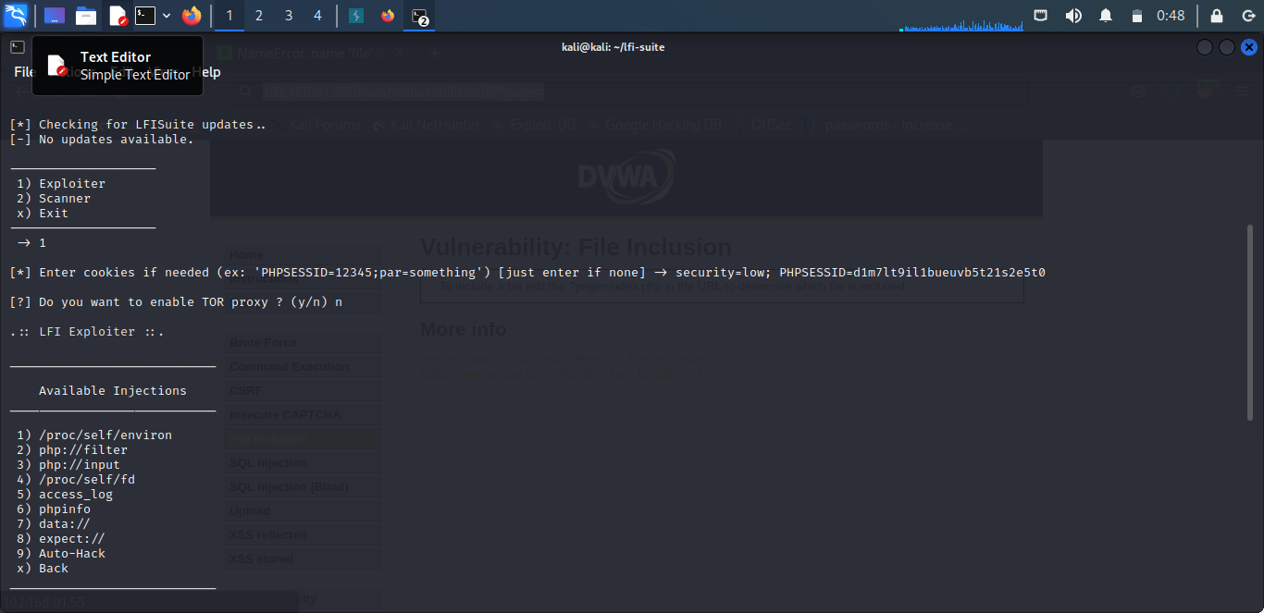
STEP- 5:

Slide 11
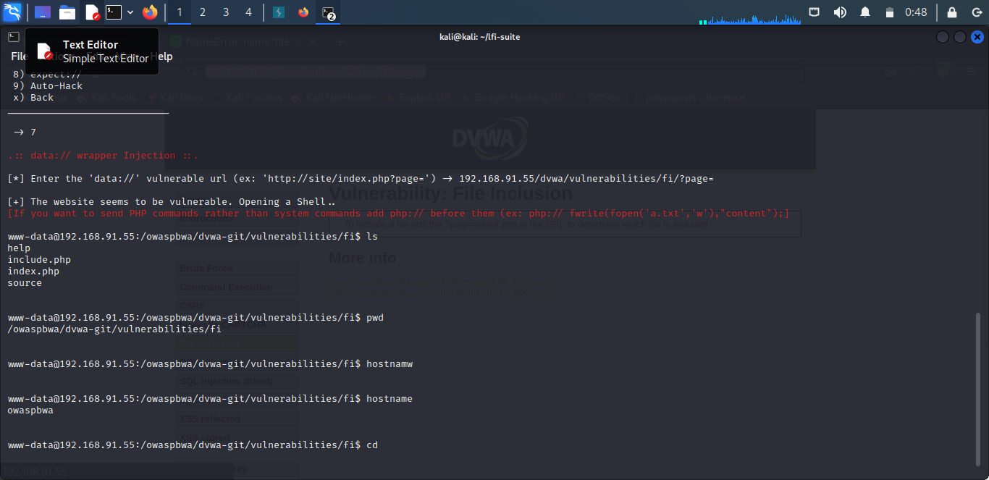
STEP- 6:

Slide 12
FILE INCLUSION ON BWAPP THROUGH BURP SUITE
BURP SUITE :
Burp or Burp Suite is a set of tools used for penetration testing of web applications. It is developed by the company named Port swigger, which is also the alias of its founder DafyddStuttard. Burp Suite aims to be an all in one set of tools and its capabilities can be enhanced by installing add-ons that are called BApps.
Features:
Target - This tool contains detailed information about your target applications, and lets you drive the process of testing for vulnerabilities.
Proxy - This is an intercepting web proxy that operates as a man-in-the-middle between the end browser and the target web application. It lets you intercept, inspect and modify the raw traffic passing in both directions.
Scanner Professional - This is an advanced web vulnerability scanner, which can automatically crawl content and audit for numerous types of vulnerabilities.
Intruder - This is a powerful tool for carrying out automated customized attacks against web applications. It is highly configurable and can be used to perform a wide range of tasks to make your testing faster and more effective.
Repeater - This is a tool for manually manipulating and reissuing individual HTTP requests, and analyzing the application's responses.
Sequencer - This is a sophisticated tool for analyzing the quality of randomness in an application's session tokens or other important data items that are intended to be unpredictable.

Slide 13
Decoder - This is a useful tool for performing manual or intelligent decoding and encoding of application data.
Comparer - This is a handy utility for performing a visual "diff" between any two items of data, such as pairs of similar HTTP messages.
Extender - This lets you load Burp extensions, to extend Burp's functionality using your own or third-party code.
Logger - This is a tool for recording and analyzing HTTP traffic that Burp Suite generates.
Inspector - This provides some useful features for analyzing and editing HTTP and WebSockets messages.
Collaborator client Professional - This is a tool for making use of Burp Collaborator during manual testing.
DOM Invader - This is a tool for finding DOM XSS vulnerabilities
Click bandit - This is a tool for generating Clickjacking attacks.
Mobile Assistant - This is a tool to facilitate testing of mobile apps with Burp Suite.

Slide 14
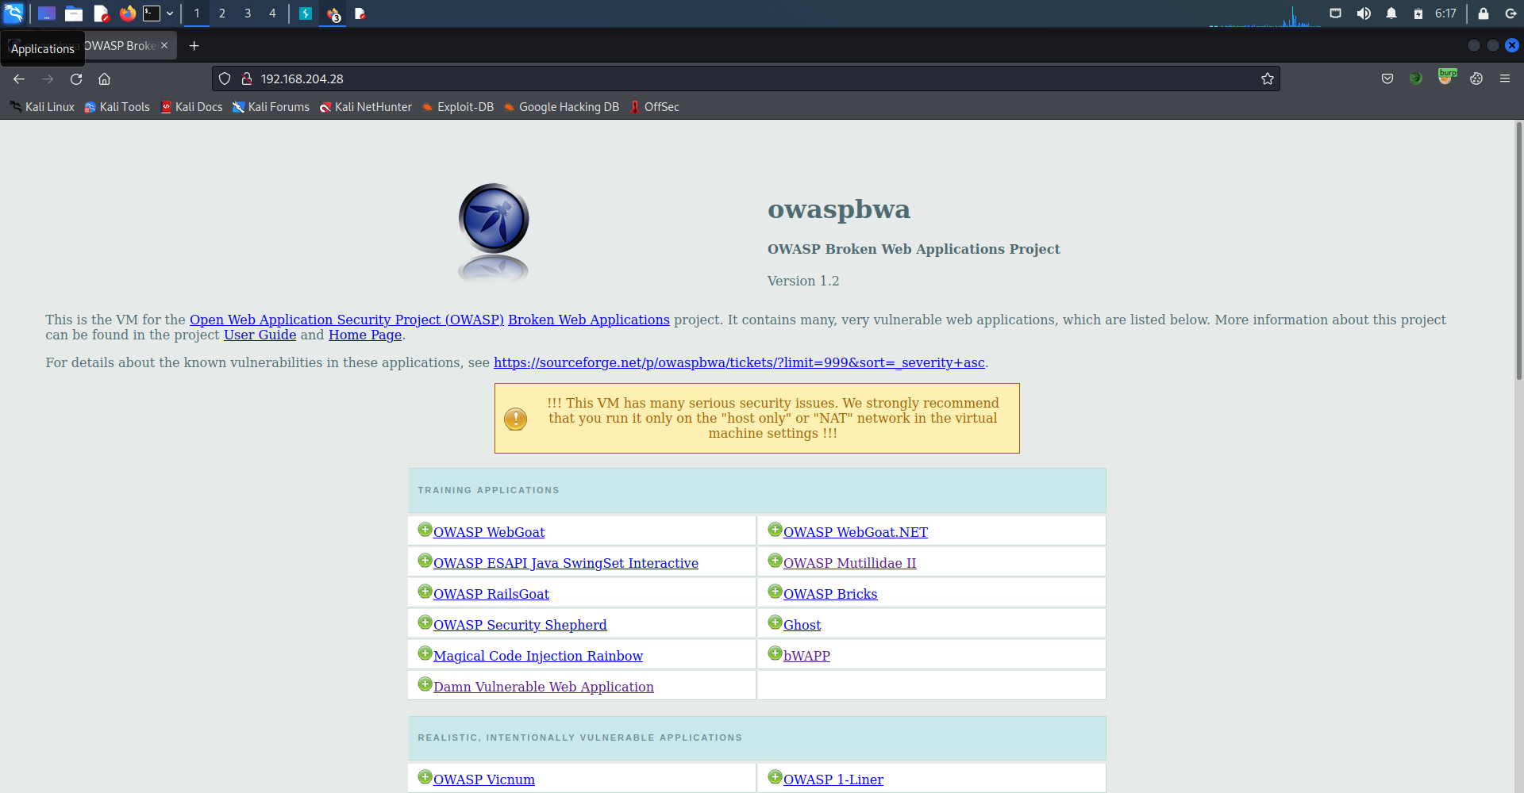
i
Implementation Of File Inclusion Through bWAPP
i
Open the owaspbwa home page in the web browser using the IP address owaspbwa server
Open bWAPP

Slide 15
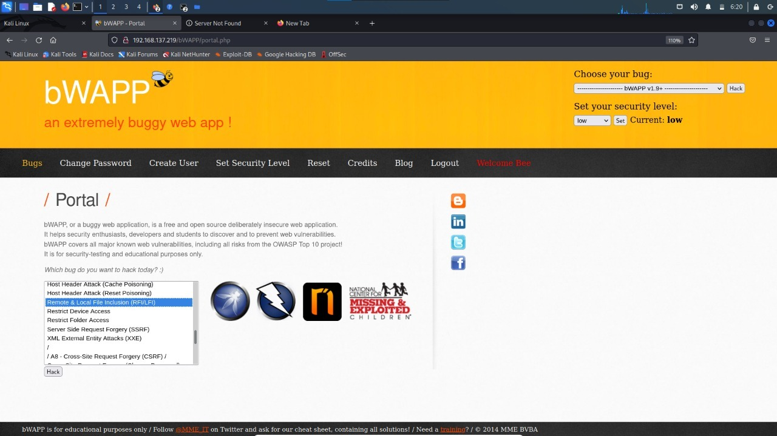
STEP -2:

Slide 16
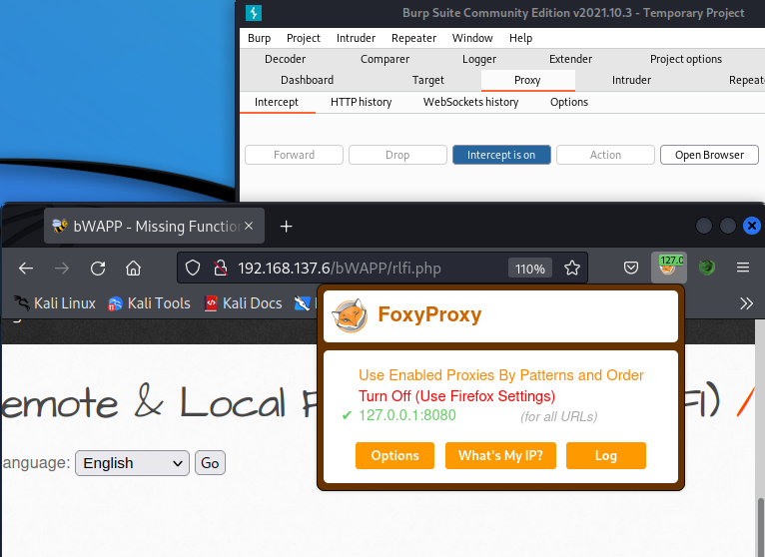
STEP -3:
Here we have to turn on the proxy and open burp suite to capture the request

Slide 17
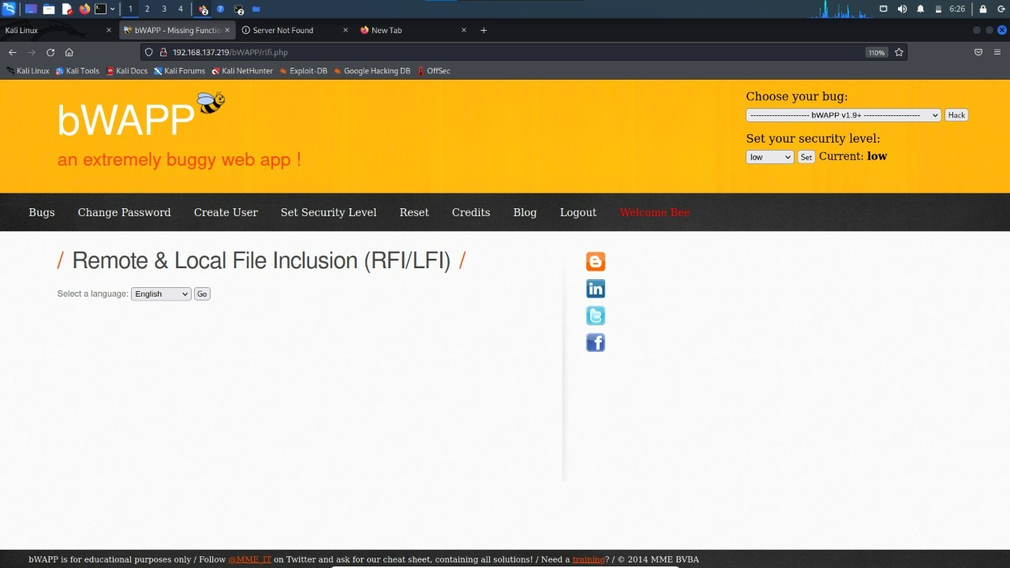
STEP - 4:
i

Slide 18
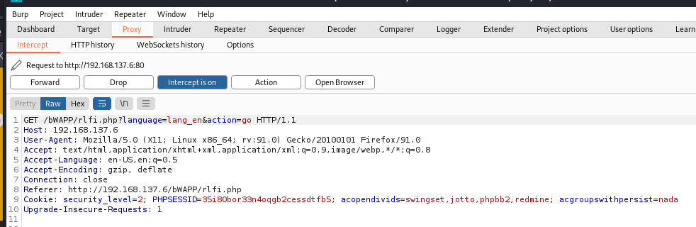
STEP -5:
Here we capture the request and it will be sent to repeater

Slide 19
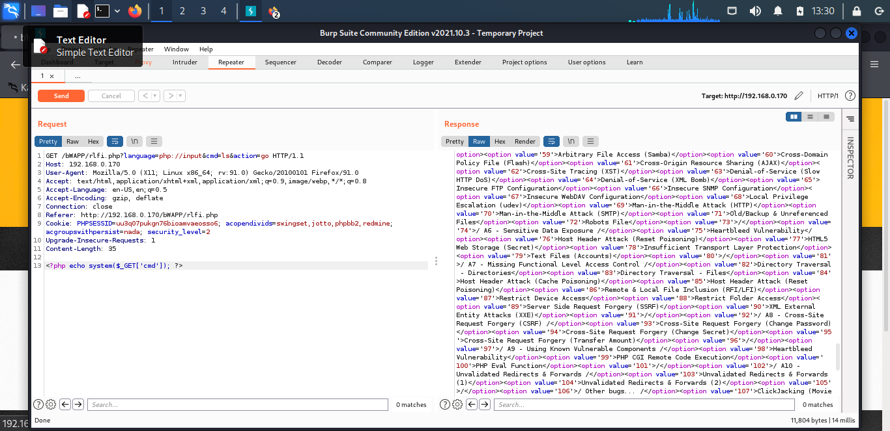
STEP-6:
Here we will change the input field
i

Slide 20
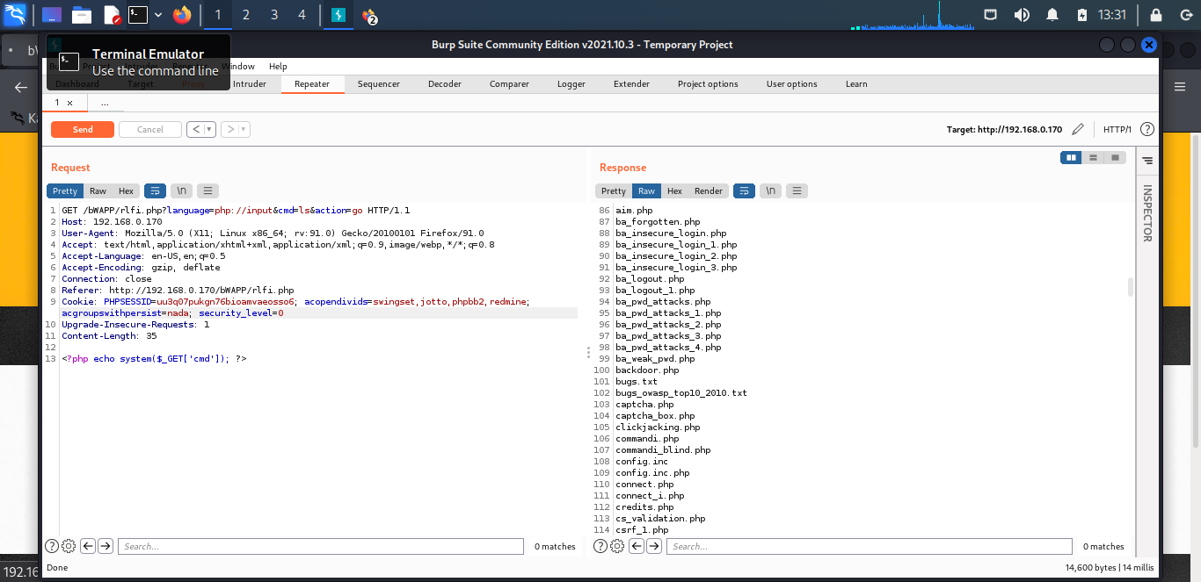
STEP-7:
i

Slide 21
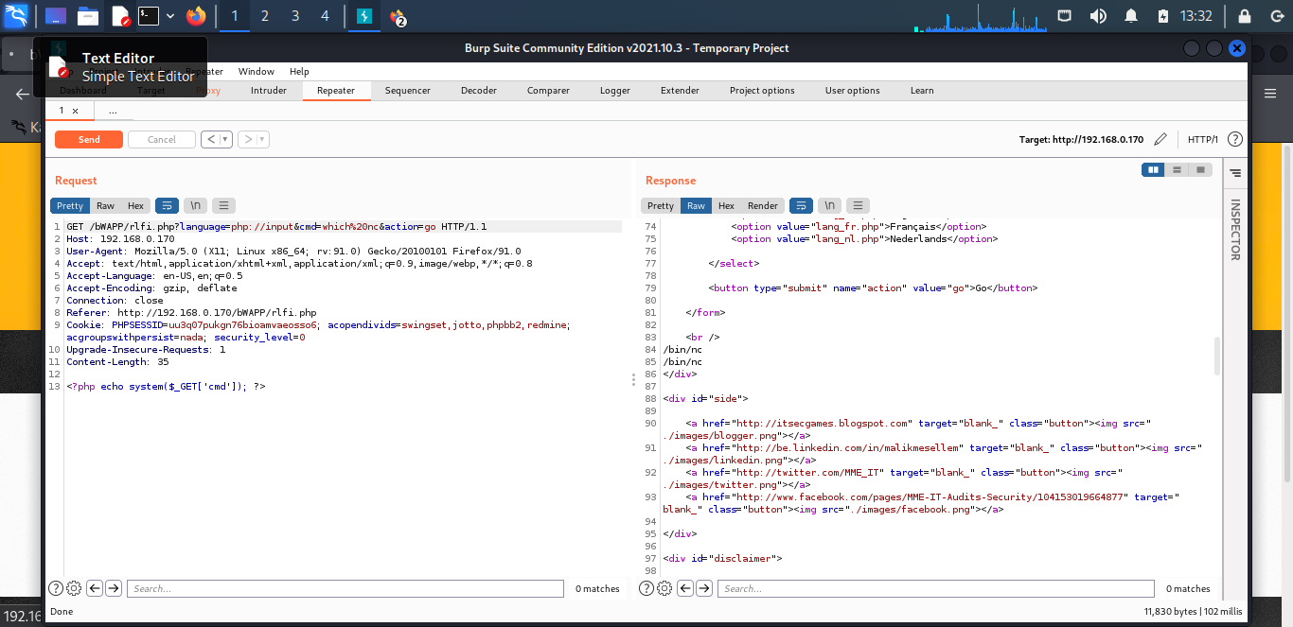
STEP - 8:
i

Slide 22
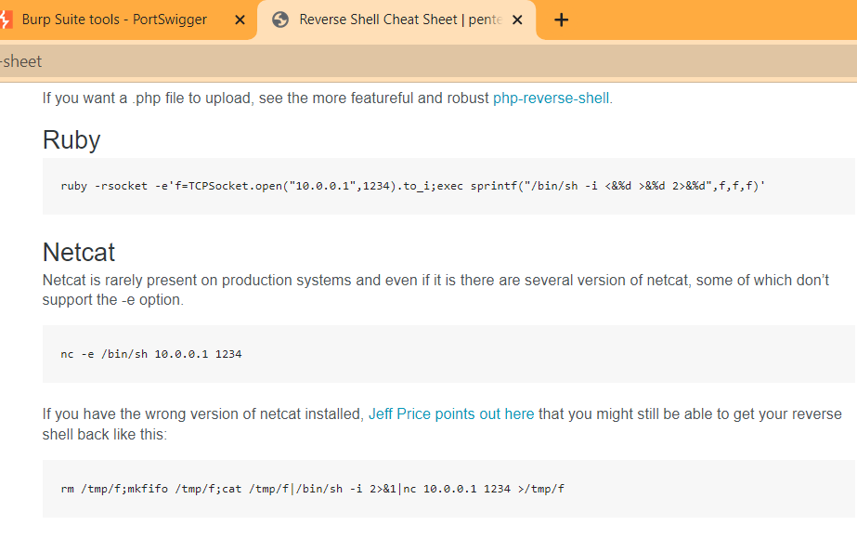
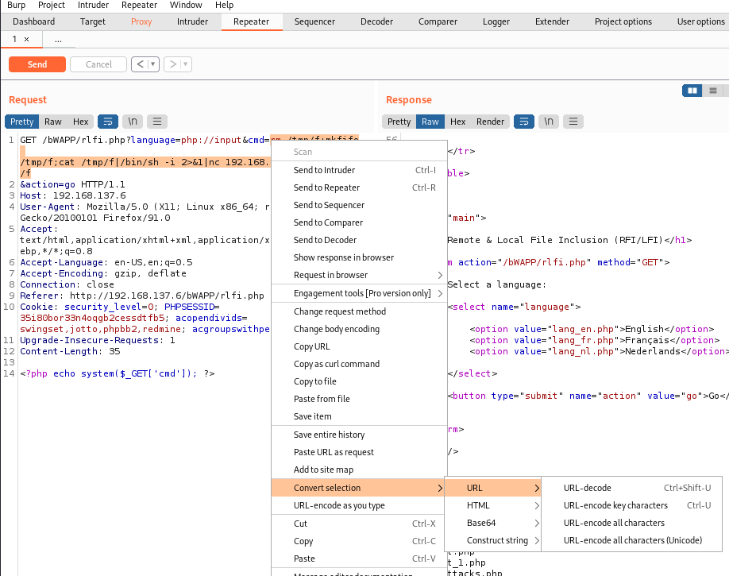
STEP - 9:
i

Slide 23
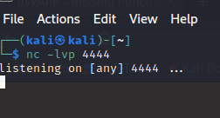
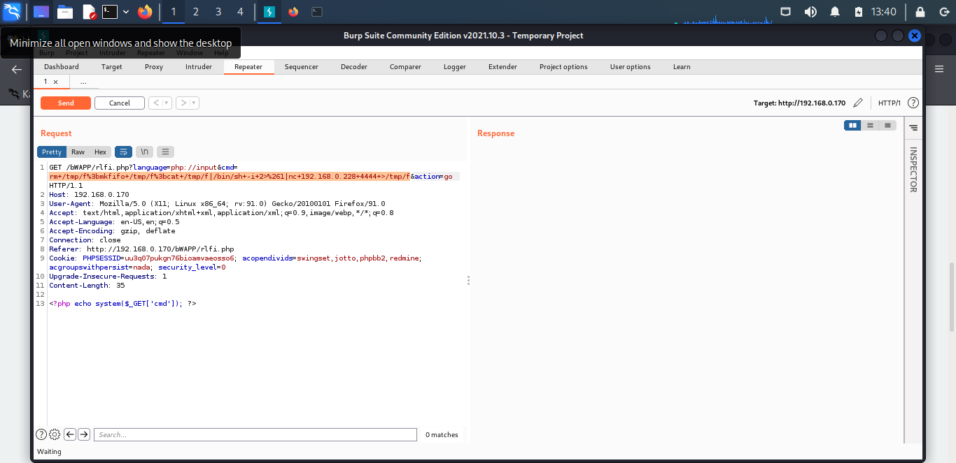
i
STEP- 10:

Slide 24
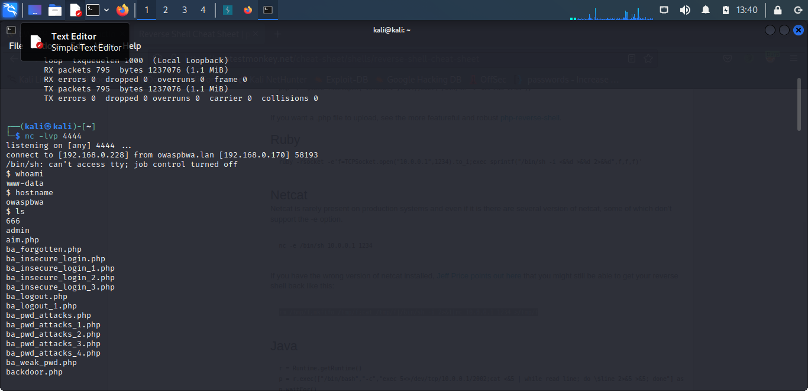
STEP -11:
i

Slide 25
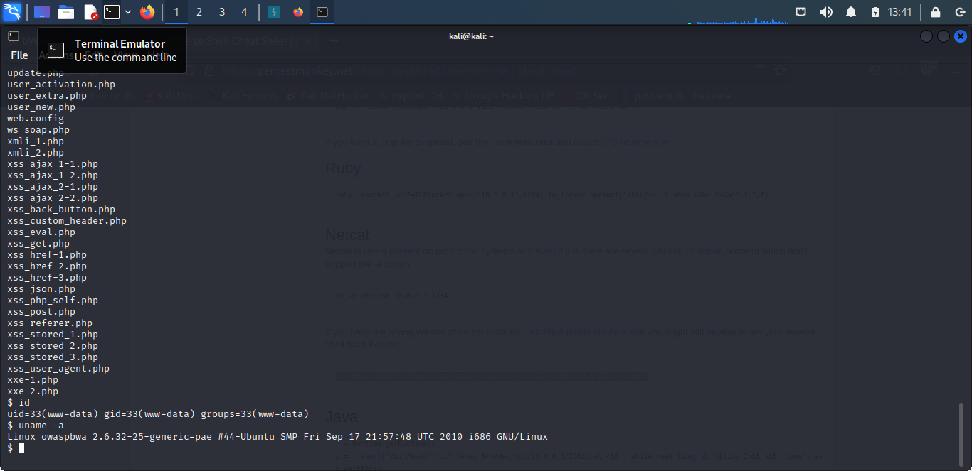
STEP -12:
i
Here we can access all files and we can create and delete files ,we can traverse the all directories.

Slide 26
i
Conclusion
The most effective solution to eliminate file inclusion vulnerabilities is to avoid passing user-submitted input to any filesystem/framework API. If this is not possible the application can maintain an allow list of files, that may be included by the page, and then use an identifier (for example the index number) to access to the selected file. Any request containing an invalid identifier has to be rejected, in this way there is no attack surface for malicious users to manipulate the path.

Slide 27
Presented By:
PAPASANI VENKATA RAVINDRA REDDY
PUVVADA NAGENDRA SAI KIRANU
RAVURI MARTIN MADHAV
SARIKOKKULA SALOMAN RAJU
SHAIK RIZWAN AHMED
THANK YOU

